Slide 1
Bank Customers Churn
Raden Ameer, Ain Salwa, Ainul Fatihah

Slide 2
Table of Content
Introduction
Analysis
Modeling
Performance Evaluation
Key Findings
Business Recommendations
Limitations & Future Works

Slide 3
Introduction
Project Objective
Customer Churn is well known as customer leaves a company over a given time. Retaining existing customer has always been priority for the bank as bringing new customer might cost more money.
To predict customers churn in order to prevent possible profit loss for the bank.
Notes:
Customer churn is a phenomenon related to customer leaving the company. Therefore this is something we would like to prevent as it cost more to bringing new customers rather than retaining the existing customer. A study made by harvard business school, it was reported 25-95% profit is increase with existing customer. With the collected information/dataset we able to perform several analytics and modelling to predict customer churn. The next slide able to help visualize the importance of certain key variables.

Slide 4
Analysis
Further analysis on the dataset to identify and visualize customer churn.

Slide 5
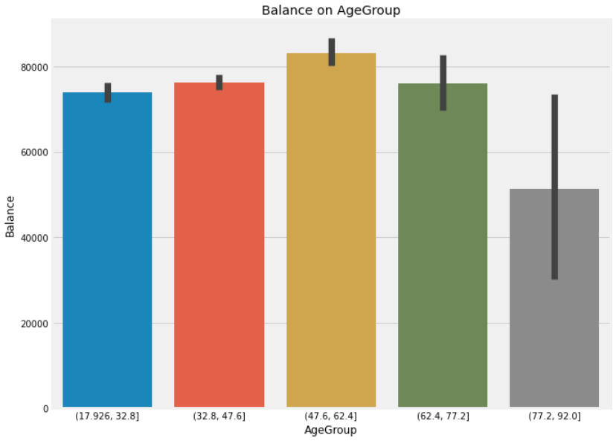
Customers’ Information
Gender | Female | Male
Geography
France | 2,261 | 2,753 | 5,014
Germany | 1,193 | 1,316 | 2,509
Spain | 1,089 | 1,388 | 2,477
 | 4543 | 5457
Notes:
These are informations extract from the collected dataset, as we know most of our customers come from france and most of them are male. Furthermore, we grouped the age into 5 category with interval of 15 years each and check their balance, most of our middle age customers have the highest balance in the bank.

Slide 6
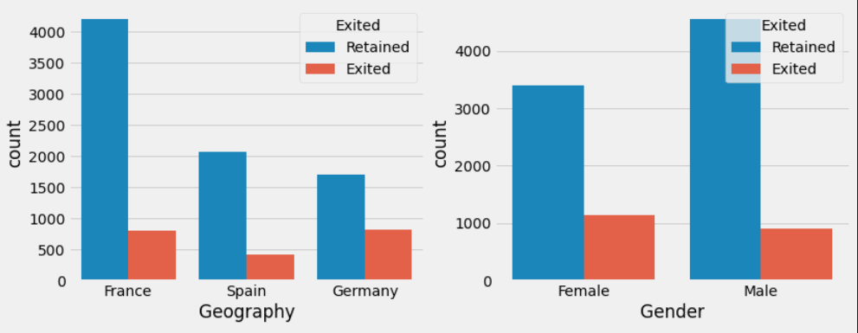
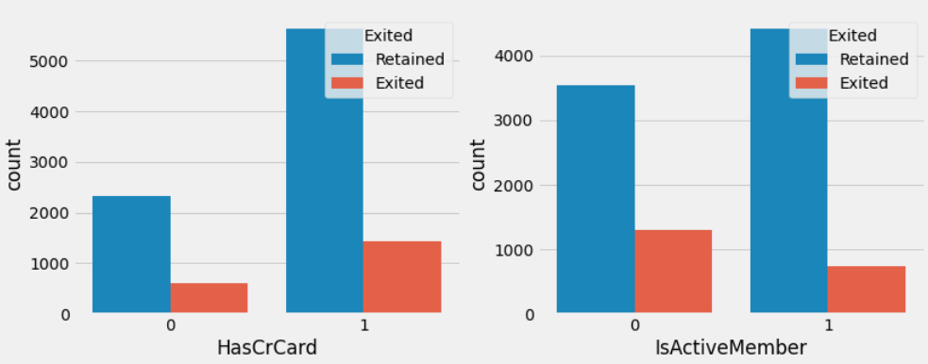
Customers’ Exit Identification
Notes:
With information we have gathered from previous slide, We would like to deep dive into the Exited customers information according to several variables. These graph shows the customers’ identification such as their geography, gender and their relevance to the banking such as owning credit card and activity. This we understand that most customers that Exited comes from germany, Female, own credit card and not an active member.

Slide 7
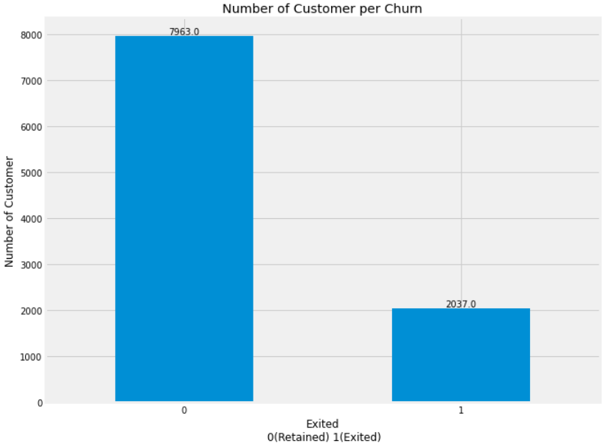
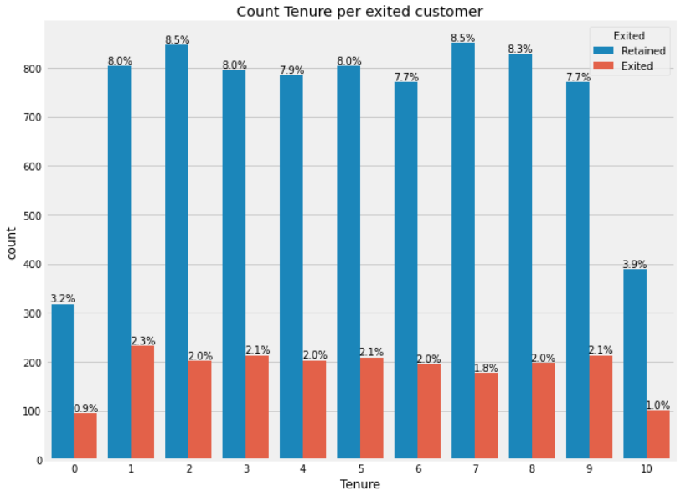
Exit customer
Notes:
We continue focusing on our target which is the Exited variable where we will check on certain information to observe if there is any pattern that concern us.

Slide 8
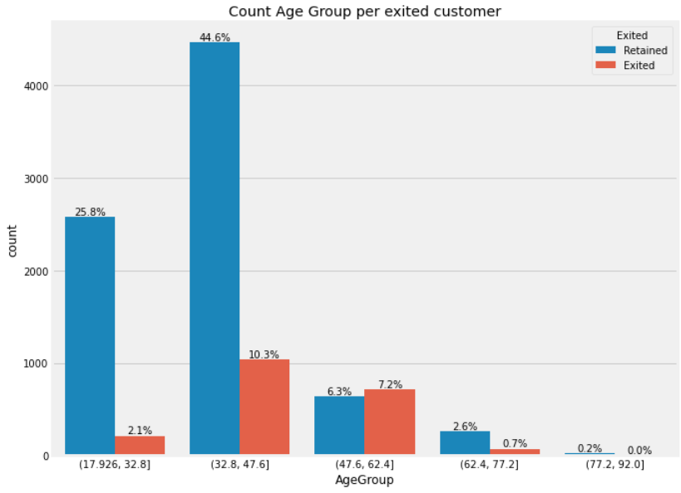
Exit customer
Notes:
Most of our middle age customer are the one that leaving our services. Next we will use this important information to do further modeling so we able to predict the customer churn.

Slide 9
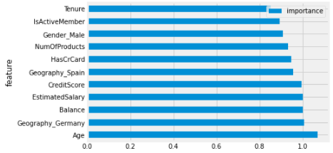
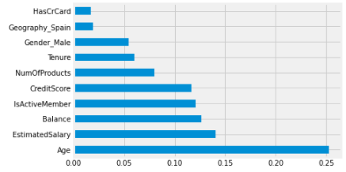
Modeling
Logistic Regression
Decision Tree
As the problem is classification problem, three algorithm based on classification had been choose as follows:
Logistic Regression
Decision Tree
k-Nearest Neighbor
Logistic Regression and Decision Tree choose Age as the most importance variable in predicting either the customers will retained or exited from bank
Notes:
Age is the most important variables for predict customer churn following other variables as visualize in Logistic Regression and Decision Tree chart

Slide 10
Key Insights from Model
Variables | Odds Ratio | Explanation
Age | 1.02 | For every one unit increases with age, the odd to be exited increases by 2%
Credit Score | 0.99 | For every one unit increases with credit score, the odd to be exited decreases by 1%
Gender | 0.79 | Female customer more likely to be exited than male
Geography_Germany | 1.02 | Customer from Germany more likely to be exited than customer from France
Geography_Spain | 0.85 | Customer from France more likely to be exited than customer from Spain
Has Credit Card | 0.90 | Customer without credit card more likely to be exited than customer with credit card
Is Active Member | 0.74 | Non-active customer more likely to be exited than active customer
Number of Products | 0.92 | For every one unit increases with number of products, the odd to be exited decreases by 8%
Tenure | 0.99 | For every one unit increases with tenure, the odd to be exited decreases by 1%
Notes:
Here, we see the value of odds ratio to see the probability of each features

Slide 11
Performance Evaluation
Matrices / Model | Logistic Regression | Decision Tree | kNN
Accuracy | 69% | 79% | 69%
Precision | 70% | 79% | 67%
Recall | 68% | 80% | 78%
F1-Score | 69% | 79% | 72%
Suggest to use Decision Tree model as it gives the highest accuracy and performance in predicting either customers will retained or exited from bank
Notes:
We compare the three model with 4 matrices. Overall, all model give good performance, but suggest to use Decision Tree.
Accuracy indicate the percentage of correctly predict by model.
Precision indicate percentage of True positive from prediction of the model.
Recall indicate percentage of True Positive predict by model based on actual classification
F1 helps to measure Recall and Precision at the same time

Slide 12
Key Findings for Business
20.4% (2,037 out of 10,000) customers from Spain, France and Germany had terminated their services with the bank after 6 months.
Most of the proportions of customers that Exited are in Germany.
Age group of 30 - 40.
Female customers
Has credit card
Non-active customers
This model uses customer’s data to identify and predict the possibility of customers churn after 6 months with 79% accuracy.
More likely to churn

Slide 13
Business Recommendation
Engage with customers who have high possibility of terminating their service with the bank.
Improve the credit card system and the reward-based system to its customers, especially to the loyal and high-spending customers.
To provide push promotion via direct selling, newsletter, message and advertisement to targeted customers .

Slide 14
Limitations & Future Works
Data limitation is too biased toward customer retention. Need to increase sample size to further accurately improve the model.
Need to conduct more research on customers in Germany and France to further analyse their financial behaviour.
Suggest to add a few other variables, such as customer satisfaction survey, to the data.

Slide 15
References:
https://www.superoffice.com/blog/reduce-customer-churn/
https://hbswk.hbs.edu/archive/the-economics-of-e-loyalty
https://www.kaggle.com/artemsolomko/customer-churn-prediction

